Slide 1
MINI PROJECT - ONLINE LEARNING PORTAL
SUBMITTED BY
T JANANI

Slide 2
In Visual Studio Code
Install Angular CLI to create the project
Run the project in development server, it will be available from the address [http:// localhost:4200/].
Create 4 components of the project (home, course, join, about)
Add routing to the app-routing . Module . ts
Import the components modules in app .module .ts
Then, develop the component pages in html and describe the styles for webpage in css

Slide 3
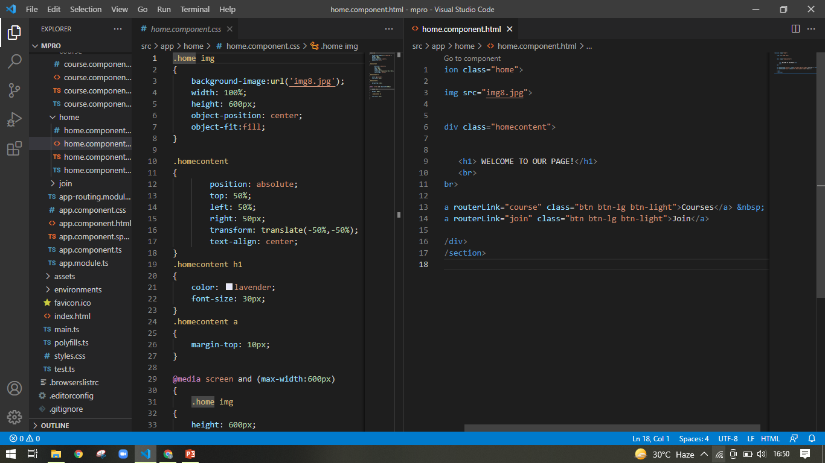
Home component OF html and css
In Html, I have mentioned background image and two buttons to displayed in a home page and styling the webpage design in CSS. In each and every page I have mentioned the footer also.

Slide 4
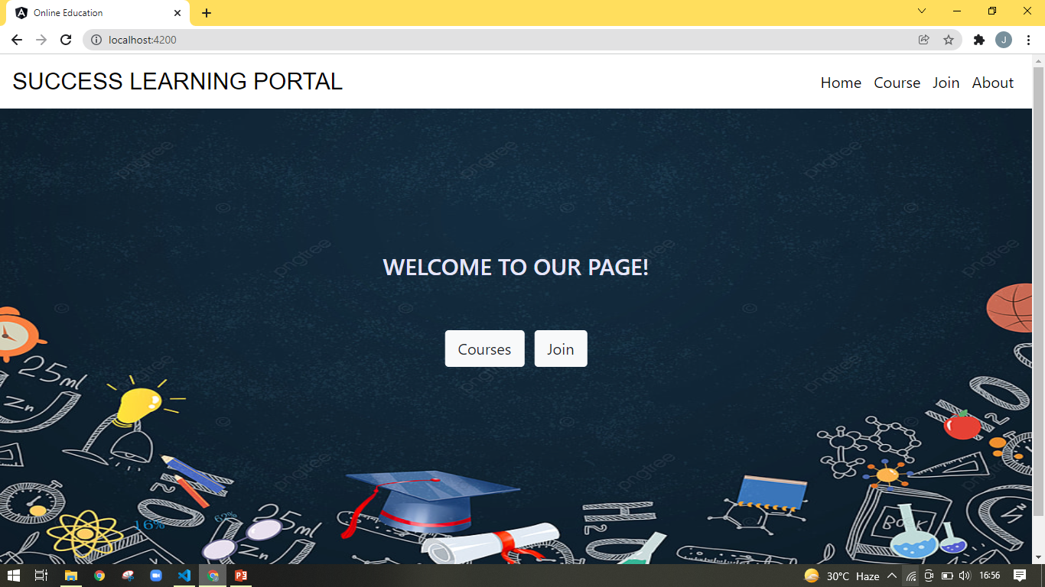
the output of home page
Here, if I click the course button it will go to the course page and same process for join page. Course and join page will be available in buttons and in validations also.

Slide 5
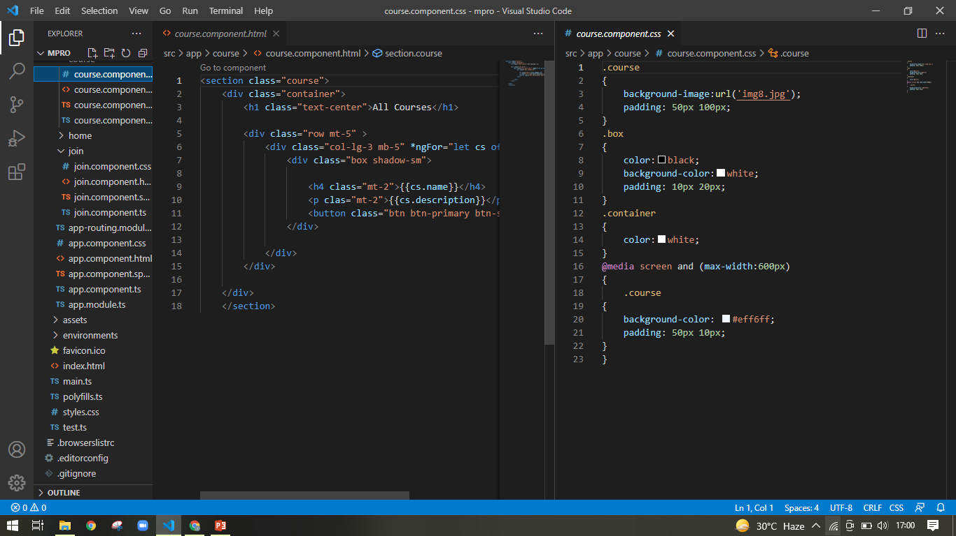
Course component OF html and css
In Html, I have mentioned div container class for all courses to displayed the various courses which are available and I have mentioned “More” button also.

Slide 6
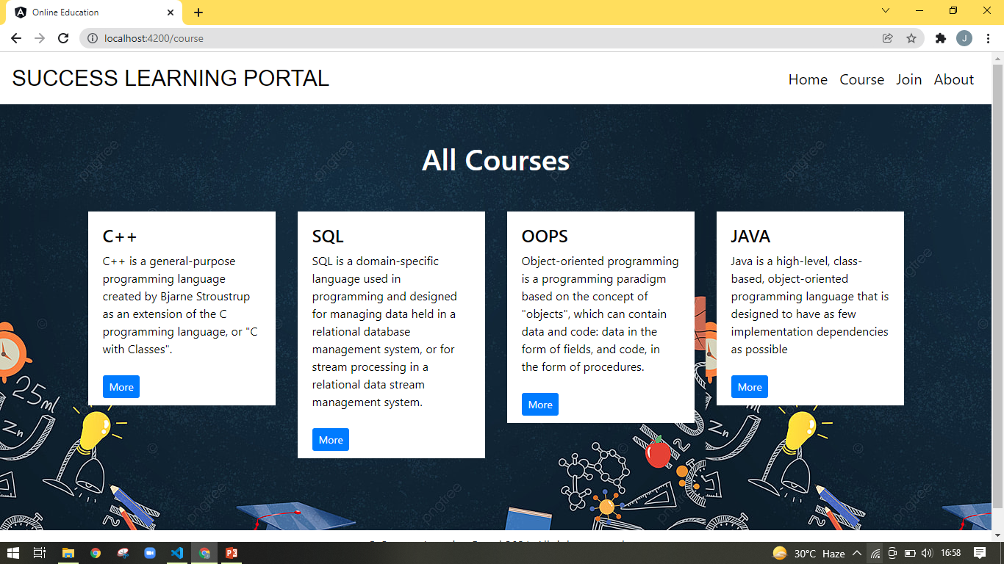
the output of course page

Slide 7
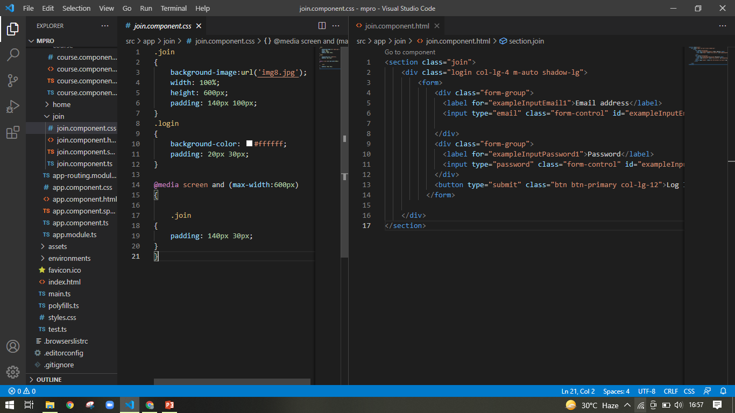
Join Component OF html and css
Here I used the form with the help of Bootstrap to displayed the page in more attractive.

Slide 8
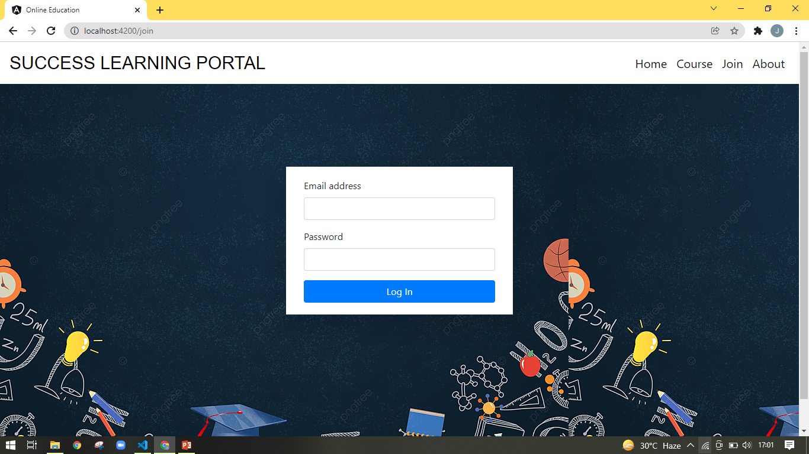
The Basic output of join page

Slide 9
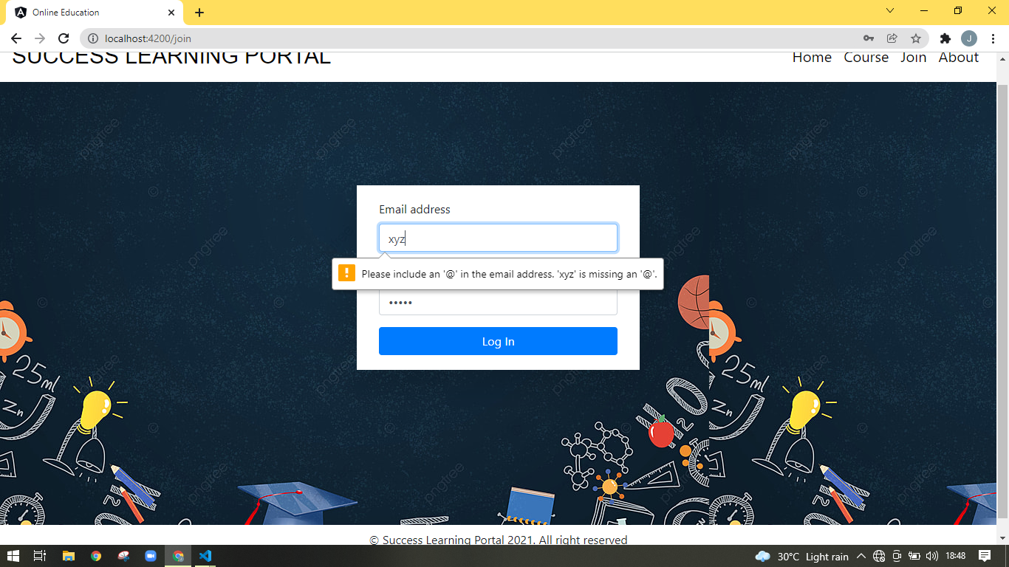
Here, If I’m not enter the full email address then it will shows an alert message like this.

Slide 10
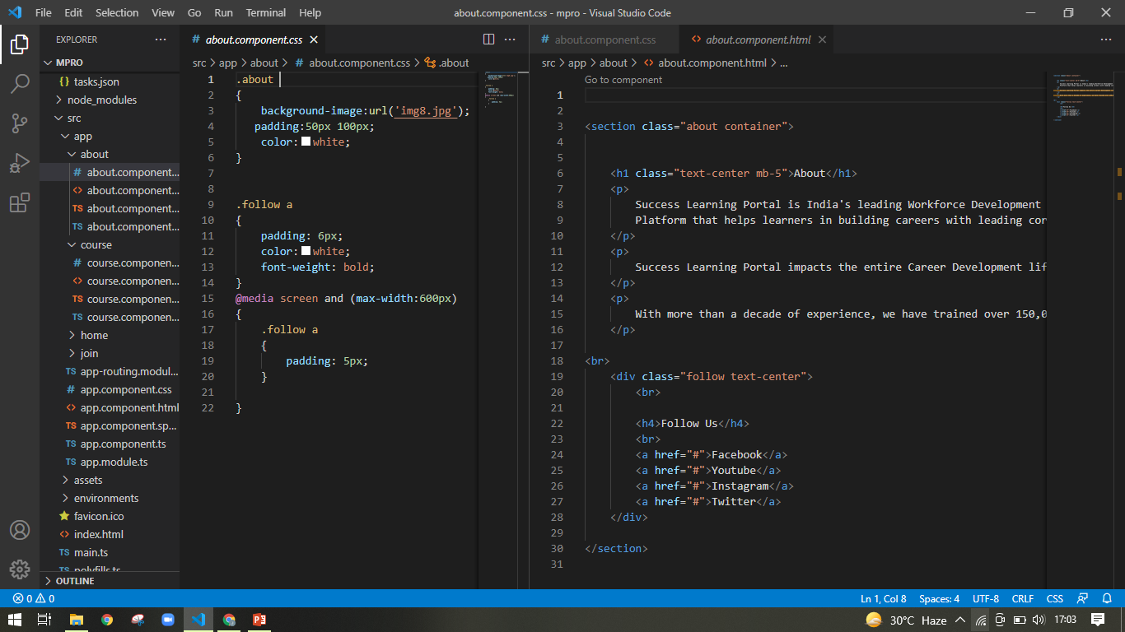
About component OF html and css
I have mentioned some details of our learning portal and link the icons in follow us.

Slide 11
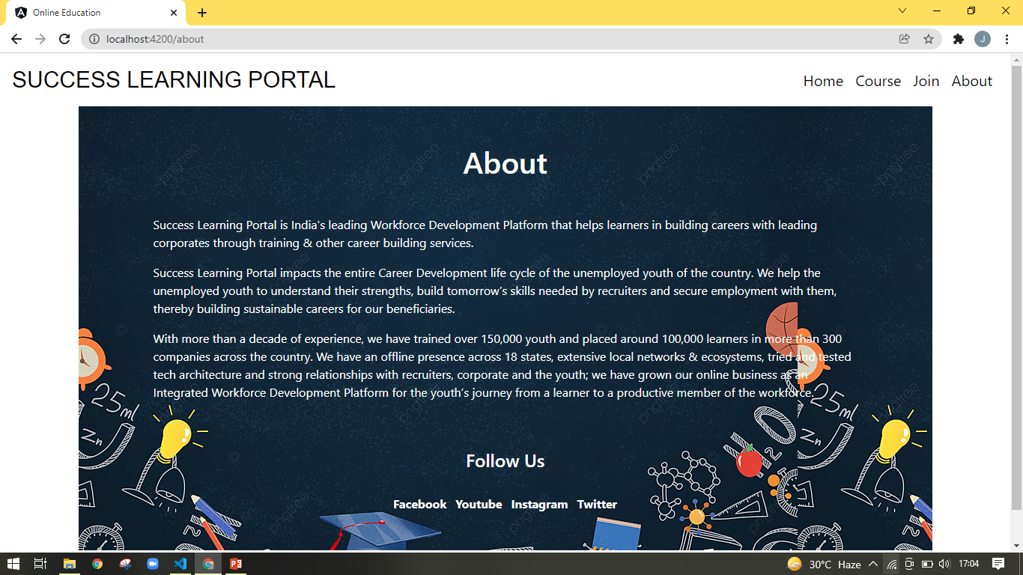
The output of about page

Slide 12
Thank you

